Slide 1

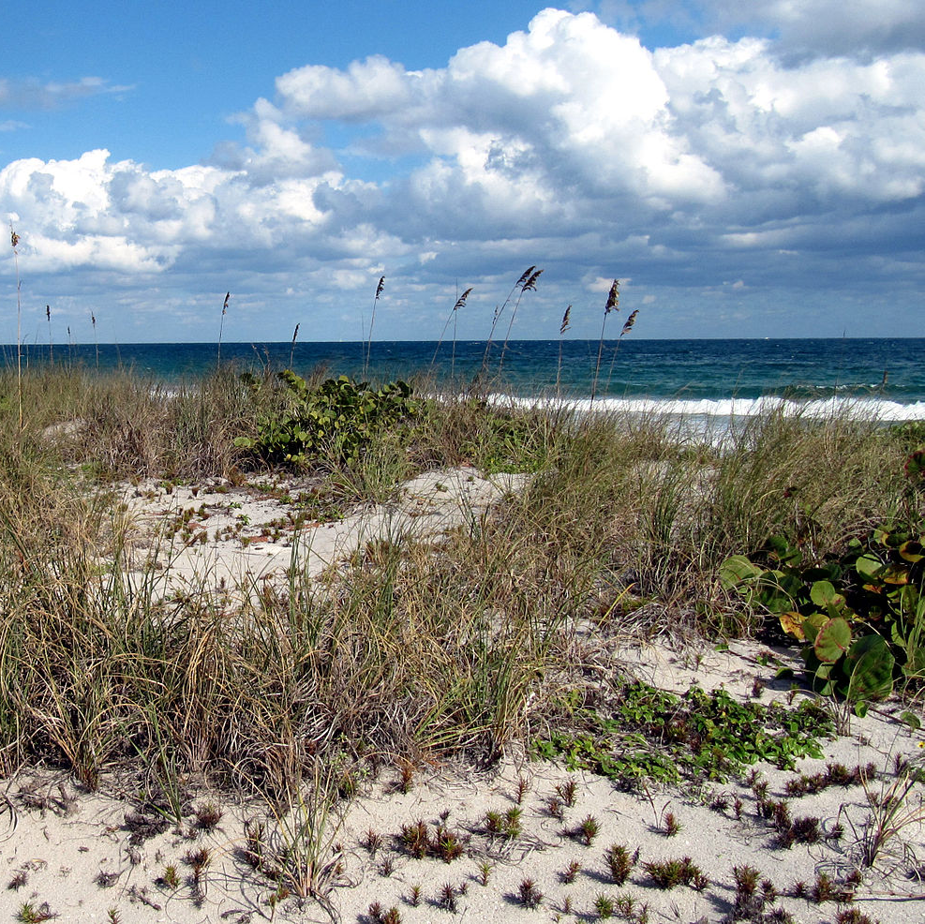

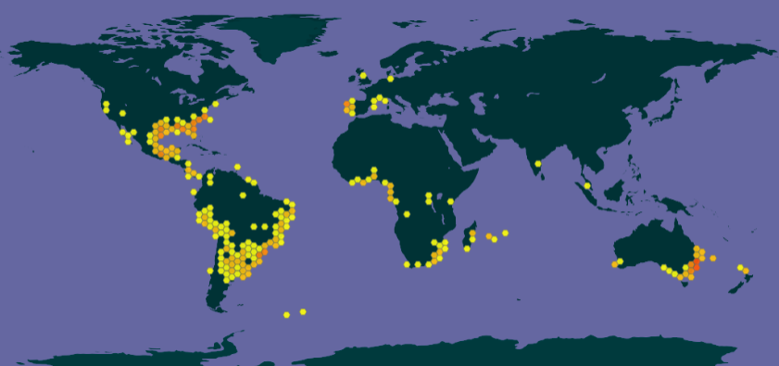

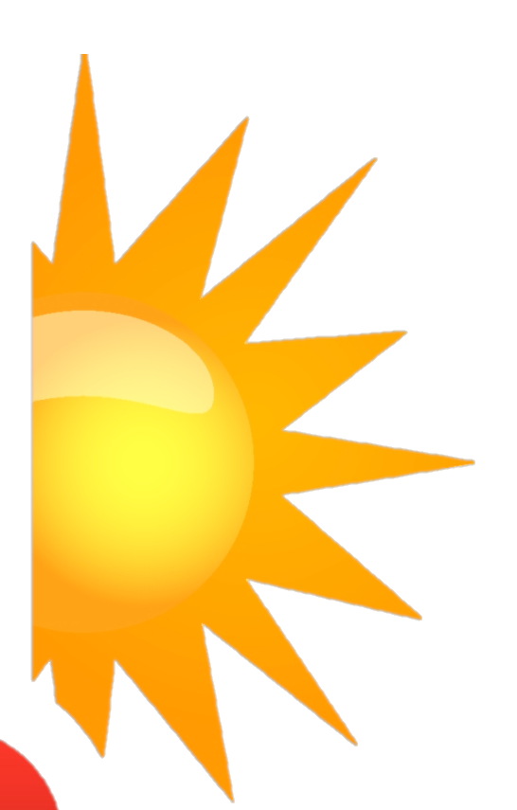

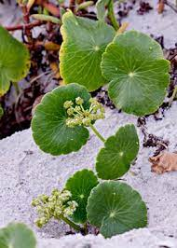
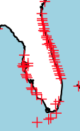



Rachel E. Bonner, Laura K. Dease, Elizabeth A. Hughston, Justin C. Bagley
Using ecological niche modeling to predict the response of Hydrocotyle bonariensis to global climate change
Department of Biology
Jacksonville State University
Jacksonville, AL 36265
INTRODUCTION
MATERIALS & METHODS
RESULTS
CONCLUSIONS
Coastal dune habitats provide valuable ecosystem services but are declining globally due to the interacting effects of multiple stressors, including global climate change (GCC). To explore the potential severity of the effects of GCC on dune plant communities of the Northern Gulf of Mexico, we modeled the fundamental bioclimatic niche ¹ of a native foredune species, largeleaf pennywort, Hydrocotyle bonariensis Comm. ex Lam. Hydrocotyle bonariensis is an herbaceous, creeping perennial plant in the family Araliaceae found on dunes and moist soils ². It is used in traditional medicine in South America ². While H. bonariensis prefers higher elevations, it is commonly found in coastlines of the Afrotropics, Nearctic, and Neotropics ^{2,3 (see inset map)}. This work forms part of a broader project predicting the responses of dune plant communities of Alabama’s barrier islands and shorelines to GCC.
We mined species occurrence records from museum records and citizen science observations by accessing the Global Biodiversity Information Facility (GBIF) using the rgbif package in R. This procedure yielded 7,053 raw occurrence records. After removing duplicates and cleaning with CoordinateCleaner, then spatially thinning the data with spThin in R, we reduced the dataset to 438 records.
Environmental variables included BIO01-BIO19 (bioclimatic variables, e.g. mean annual temperature) plus a digital elevation model layer (elevation), all from Worldclim. We determined that 6 variables were not highly correlated with the others based on Pearson’s r < 0.9, including: BIO02, BIO05, BIO08, BIO13, BIO18, and elevation (reduced dataset).
Our ENM projections based on models with reasonably high predictive ability indicated that the distribution of suitable habitat for H. bonariensis in the study region will likely be greatly reduced by GCC over the coming decades. Unlike other foredune plant species, H. bonariensis is known from non-dune habitats (e.g. estuaries, sandy coastal plains) up to moderate elevations ^{2,3}; accordingly, our models strikingly predict potential refugial areas for this species in Central Mexico and the northern Yucatán Peninsula. These findings suggest that concerns over responses of economically important coastal habitat vegetation to multiple threats, including GCC and human land use practices (e.g. urban development), are probably warranted, and that much more work is needed to assess synergistic effects of multiple stressors on H. bonariensis and other nearshore plant species from the Northern Gulf of Mexico. Indeed, additional analyses of codistributed dune plants in the study area are needed to test the generality of these findings H. bonariensis for regional dune plant communities, and to evaluate ecological trends of species responses to GCC. While H. bonariensis is an invasive or nuisance species (e.g. on lawns, golf courses) in parts of its range, our analyses suggest such habits may continue to be an issue, albeit in suitable areas and with modification to accommodate shifting coastlines, which are expected due to the sea-level rise effects of GCC.
Separate analyses using the same thinned occurrences and the full vs. reduced environmental layer sets yielded similar models with similarly good–high predictive performance, based on AUC scores of 0.90 to 0.85, respectively. In both models, elevation and temperature variables (BIO02, mean diurnal range, or BIO07, temperature annual range) had the highest % contribution and importance. Projecting these models onto stacked environmental rasters for current environments revealed that predictions had good agreement with the known distribution of H. bonariensis (panels A, B below). However, projecting these models onto rasters reflecting a GCC scenario for 2070 showed greatly reduced habitat suitability ~50 years from now, with massive reductions in favorable conditions along coastlines. Both models predicted ‘refuge’ areas with high habitat suitability in the interior of Central Mexico (panels C, D below). However, only the full dataset’s future prediction included a large refugial area in the Yucatán Peninsula region.
Predicted Current Occurrences of Hydrocotyle bonariensis
OBJECTIVES
Hydrocotyle bonariensis Comm. ex Lam.
H. bonariensis global distribution (GBIF)
1. Data collection and preparation
Obtain species occurrences (presence-only records) from Global Biodiversity Information Facility (GBIF; gbif.org)
1. Data Preparation
REFERENCES
Clean occurrences (cleaning, spatial thinning to ~10 km)
Obtain environmental variable data layers, cut to study area (200 km buffer zone) ^{4,5}
Current environments: Worldclim v2.1, 30-s resolution ⁴
Future environments: CMIP5 2070 data, 30-s resolution (CESM1-CAM5-1-FV2 circulation model, RCP 4.5 scenario) ⁴
2. Ecological niche modeling (ENM) ^{1,6–9}
ENM analysis using maximum entropy (MaxEnt) algorithm ¹ in R (dismo) ¹⁰
Compare full (20-var.) vs. reduced (6-var.) datasets
3. Model projection, tuning, and evaluation
Project model onto future climate layers (2070, RCP 4.5)
Compare predicted current distribution of bioclimatically suitable habitat against that under global climate change (year 2070 predictions)
Tune model parameters with ENMevaluate for final model runs
Largeleaf Pennywort H. bonariensis current distribution
(Photo credit: plantdetail.shtml)
Peterson, A.T., Soberón, J., Pearson, R.G., Anderson, R.P., Martínez-Meyer, E., Nakamura, M., Araújo, M.B., 2011. Ecological Niches and Geographic Distributions (MPB-49). Princeton University Press, New York.
Ouviña, A.G., Flores, M.L., 2021. Hydrocotyle bonariensis Comm. ex Lam. In: Medicinal and Aromatic Plants of South America Vol. 2, pp. 261–270). Springer.
Knight, T.M., Miller, T.E., 2004. Local adaptation within a population of Hydrocotyle bonariensis. Evolutionary Ecology Research, 6(1), 103–114.
Hijmans, R.J., Cameron, S.E., Parra, J.L., Jones, P.G., Jarvis, A., 2005. Very high resolution interpolated climate surfaces for global land areas. International Journal of Climatology, 25, 1965–1978.
Hijmans, R.J., 2021. raster: Geographic Data Analysis and Modeling. R package version 3.4-13. Available at: https://CRAN.R-project.org/package=raster.
Elith, J., Graham, C.H., Anderson, R.P., Dudík, M., Ferrier, S., Guisan, A., Hijmans, R.J., Huettmann, F., Leathwick, J.R., Lehmann, A., Li, J., 2006. Novel methods improve prediction of species’ distributions from occurrence data. Ecography, 29(2), 129–151.
Phillips, S.J., Anderson, R.P., Schapire, R.E., 2006. Maximum entropy modeling of species geographic distributions. Ecological Modelling, 190(3-4), 231–259.
Merow, C., Smith, M.J., Silander, J.A. Jr., 2013. A practical guide to MaxEnt for modeling species' distributions: What it does, and why inputs and settings matter. Ecography, 36, 1058–1069.
Phillips, S., 2021. maxnet: Fitting 'Maxent' Species Distribution Models with 'glmnet'. R package version 0.1.4. Available at: https://CRAN.R-project.org/package=maxnet.
Hijmans, R.J., Phillips, S., Leathwick, J., Elith, J., 2020. dismo: Species Distribution Modeling. R package version 1.3-3. Available at: https://CRAN.R-project.org/package=dismo.
3. Model Projection, Tuning, and Evaluation
FULL DATASET
(20 env. variables)
REDUCED DATASET
(6 env. variables)
Current prediction
Habitat
suitability
Current prediction
Habitat
suitability
high
high
200-km buffered zone around thinned occurrences
Latitude
Latitude
Precipitation
low
low
A
B
METHODS
Longitude
Longitude
ACKNOWLEDGEMENTS
Ecological Niche Modeling (ENM ^{1,6}) overview:
Future prediction (2070)
Habitat
suitability
Future prediction (2070)
Habitat
suitability
We thank the JSU College of Science and Mathematics for providing space, computational resources, and IT support during this project. Additionally, we thank the JSU Department of Biology for providing funding for equipment (4 TB external hard drives) used during this research.
Species
occurrence data
Occurrences
Temperature
high
high
Step #2
Step #3
2. Current ENM
Modeled species response functions
G-space
Latitude
Latitude
G
Habitat
suitability
Predicted suitable habitat for H. bonariensis in 2070 under IPCC RCP 4.5
Predicted suitable habitat for H. bonariensis in 2070 under IPCC RCP 4.5
G-space
+
Ecological
Niche
Model
high
low
low
POSTER & CONTACT INFO
Step #1
Environmental
data
(temperature, precipitation, etc.)
(Various modeling algorithms, e.g. BIOCLIM, GARP, GLM, MaxEnt)
Latitude
C
D
Email:
rbonner2@stu.jsu.edu
jbagley@jsu.edu
E-space
Pred. bioclimatic suitability for H. bonariensis in study area, best ENMevaluate model
Longitude
Longitude
PRODUCTS:
Maps of “habitat suitability” under current and future (i.e. GCC) conditions
low
Predicted geographical distributions of H. bonariensis Comm. ex Lam. under current conditions (A, B) and future (2070) environmental conditions (C, D) assuming IPCC representative concentration pathway (RCP) 4.5 for CO₂ emissions. Panels A and C show results for the full dataset, while panels B and D show modeling results from analyses including a subset of 6 environmental variables that were not highly correlated (Pearson’s r < 0.9).
Take a picture / scan the QR Code to download the full poster.
Longitude

